Slide 1



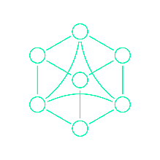
DES 2: INSTRUMENT-CLUSTER
PRESENTATION
<Team 5>
DongHwan Seo
Mounika Vinjarapu
Sujong Ha
18.08.23

Slide 2
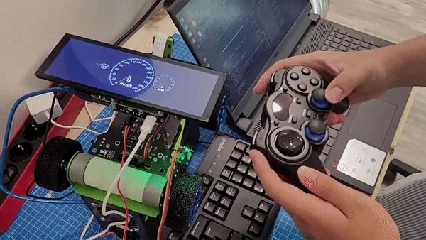
INTRODUCTION
The main goal of the Instrument-Cluster project is to create a functioning dashboard for a PiRacer car that displays real-time speed data & battery level via CAN bus.

Slide 3
INDEX
ζThread 1: Store to Buffer
Mutex
Buffer
CAN
Shield
CAN
Shield
Qt
Mutex
Speed Sensor
Arduino
UNO
Rasp Pi
Socket CAN
ζThread 2: Fetch from Buffer
Kalman
Filter
D-Bus

Slide 4
INDEX
1. Speed Sensor
ζThread 1: Store to Buffer
Mutex
Buffer
CAN
Shield
CAN
Shield
Qt
Mutex
Speed Sensor
Arduino
UNO
Rasp Pi
Socket CAN
ζThread 2: Fetch from Buffer
Kalman
Filter
D-Bus

Slide 5
INDEX
1. Speed Sensor
2. CAN Communication
ζThread 1: Store to Buffer
Mutex
Buffer
CAN
Shield
CAN
Shield
Qt
Mutex
Speed Sensor
Arduino
UNO
Rasp Pi
Socket CAN
ζThread 2: Fetch from Buffer
Kalman
Filter
D-Bus

Slide 6
INDEX
1. Speed Sensor
2. CAN Communication
3. Socket CAN
ζThread 1: Store to Buffer
Mutex
Buffer
CAN
Shield
CAN
Shield
Qt
Mutex
Speed Sensor
Arduino
UNO
Rasp Pi
Socket CAN
ζThread 2: Fetch from Buffer
Kalman
Filter
D-Bus

Slide 7
INDEX
1. Speed Sensor
2. CAN Communication
3. Socket CAN
4. Multi-Thread Synchronization
ζThread 1: Store to Buffer
Mutex
Buffer
CAN
Shield
CAN
Shield
Qt
Mutex
Speed Sensor
Arduino
UNO
Rasp Pi
Socket CAN
ζThread 2: Fetch from Buffer
Kalman
Filter
D-Bus

Slide 8
INDEX
1. Speed Sensor
2. CAN Communication
3. Socket CAN
4. Multi-Thread Synchronization
5. Kalman Filter
ζThread 1: Store to Buffer
Mutex
Buffer
CAN
Shield
CAN
Shield
Qt
Mutex
Speed Sensor
Arduino
UNO
Rasp Pi
Socket CAN
ζThread 2: Fetch from Buffer
Kalman
Filter
D-Bus

Slide 9
INDEX
1. Speed Sensor
2. CAN Communication
3. Socket CAN
4. Multi-Thread Synchronization
5. Kalman Filter
6. D-Bus
ζThread 1: Store to Buffer
Mutex
Buffer
CAN
Shield
CAN
Shield
Qt
Mutex
Speed Sensor
Arduino
UNO
Rasp Pi
Socket CAN
ζThread 2: Fetch from Buffer
Kalman
Filter
D-Bus

Slide 10
INDEX
1. Speed Sensor
2. CAN Communication
3. Socket CAN
4. Multi-Thread Synchronization
5. Kalman Filter
6. D-Bus
7. Qt
ζThread 1: Store to Buffer
Mutex
Buffer
CAN
Shield
CAN
Shield
Qt
Mutex
Speed Sensor
Arduino
UNO
Rasp Pi
Socket CAN
ζThread 2: Fetch from Buffer
Kalman
Filter
D-Bus

Slide 11
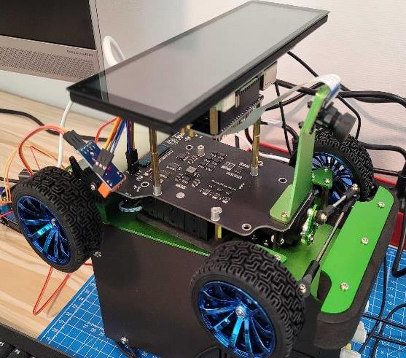
Hardware & Software Setup
Hardware
Software
〮 Waveshare Piracer
〮 Raspberry Pi 4 B 4GB
〮 2-CH CAN FD HAT
〮 7.9inch DSI LCD
〮 Arduino UNO
〮 CAN-Bus Shield
〮 IR Speed Sensor
〮 Rasbian Lite(Server) 64
〮 Qt 5.15.0
〮 Qt Creator 4.15.0

Slide 12
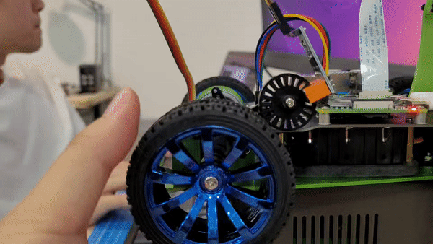
1. Speed Sensor
〮 Calculate period between 20 pulses and update last measurement time
void setup()
{
attachInterrupt(digitalPinToInterrupt(3), Pulse_Event, RISING);
〮〮〮
}
void Pulse_Event()
{
PeriodBetweenPulses = micros() - LastTimeWeMeasured;
LastTimeWeMeasured = micros();
〮〮〮
}

Slide 13
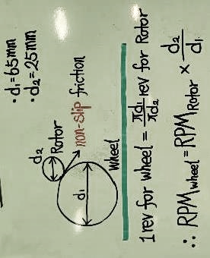
1. Speed Sensor
〮 Convert data to RPM & speed of the Piracer
1. RPMwheel = RPMRotor / 2.6
2. SpeedCar = RPMRotor * 3.4 [mm/s]

Slide 14
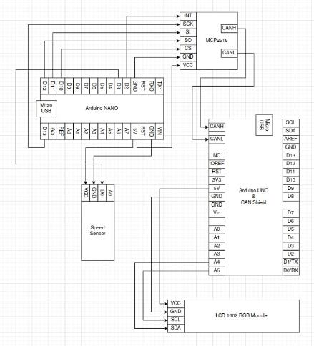
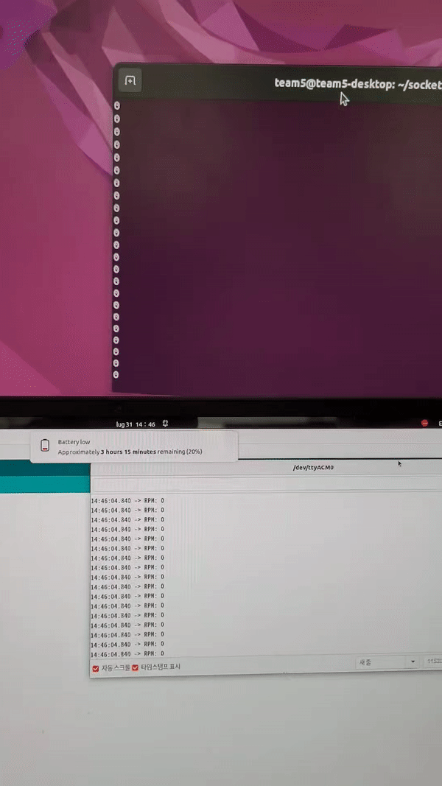
2. CAN Communication
〮 Arduino NANO to Arduino UNO
〮 Arduino UNO to Raspberry Pi
〮 500Kbps
〮 16MHz

Slide 15
2. CAN Communication
Send(Arduino)
Receive(C)
struct can_frame canMsg1;
〮〮〮
int open_port(const char *port) {
〮〮〮
struct can_filter rfilter[1];
〮〮〮
rfilter[0].can_id = 0x0F6;
}
void loop() {
〮〮〮
canMsg1.can_id = 0x0F6;
canMsg1.can_dlc = 2;
canMsg1.data[0] = (RPM & 0xFF00) >> 8;
canMsg1.data[1] = (RPM & 0x00FF);
mcp2515.sendMessage(&canMsg1);
}
void read_port(uint16_t *speed_sensor_rpm) {
struct can_frame frame;
〮〮〮
if (frame.can_id == 0x0F6) {
*speed_sensor_rpm = (frame.data[0] << 8) + frame.data[1];
}
}

Slide 16
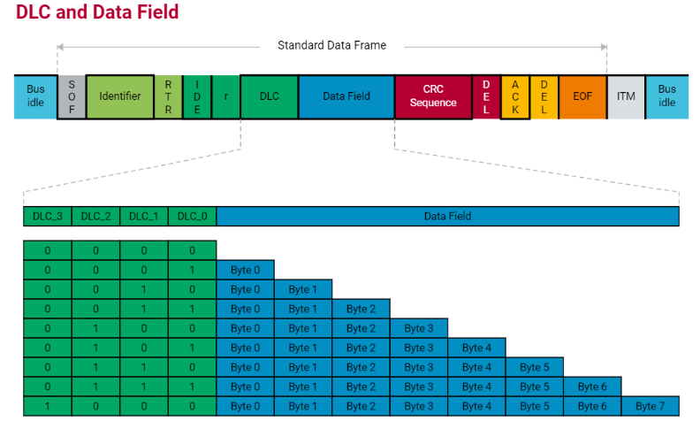
2. CAN Communication
CAN Frame Structure

Slide 17
3. Socket CAN
let RPM = 300 = 100101100(2)
(RPM & 0xFF00) >> 8
(RPM & 0x00FF)
00000001 00101100
Data[0]
Data[1]
Data[2]
Data[3]
Data[4]
Data[5]
Data[6]
Data[7]
RPM = (frame.data[0] << 8) + frame.data[1]

Slide 18
3. Socket CAN
let RPM = 300 = 100101100(2)
(RPM & 0xFF00) >> 8
(RPM & 0x00FF)
00000001 00101100
Data[0]
Data[1]
Data[2]
Data[3]
Data[4]
Data[5]
Data[6]
Data[7]
Factor
Offset
RPM = (frame.data[0] << 8) + frame.data[1]

Slide 19
4. Multi-Thread Synchronization
ζThread 1: Store to Buffer
Mutex
Buffer
Mutex
ζThread 2: Fetch from Buffer

Slide 20
4. Multi-Thread Synchronization
ζThread 1: Store to Buffer
Mutex
〮 Optimizing data processing speed
〮 Transmission Overhead
〮 Resource Usage
Buffer
Mutex
ζThread 2: Fetch from Buffer

Slide 21
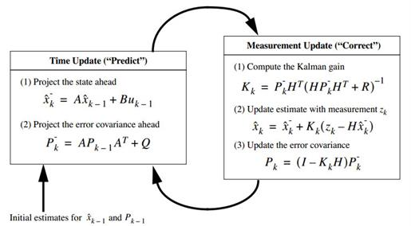
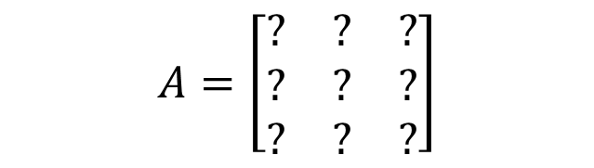
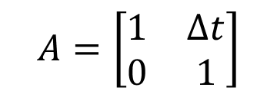

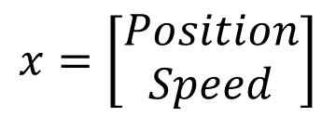
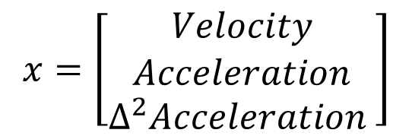
5. Kalman Filter
A, H : State Space Equation
$$Ax$$
$$x=\left[\begin{aligned}Position \\ Speed\end{aligned}\right]$$
$$A=\left[\begin{matrix}1 & ∆t \\ 0 & 1\end{matrix}\right]$$
$$current_position = past_position + ∆t ∗ past_speed$$
$$current_speed = past_speed$$
$$x=\left[\begin{aligned}\begin{aligned}Velocity \\ Acceleration\end{aligned} \\ ∆^{2}Acceleration \end{aligned}\right]$$
$$A=\left[\begin{matrix}? & ? & ? \\ ? & ? & ? \\ ? & ? & ?\end{matrix}\right]$$
→ Numerical Analysis

Slide 22
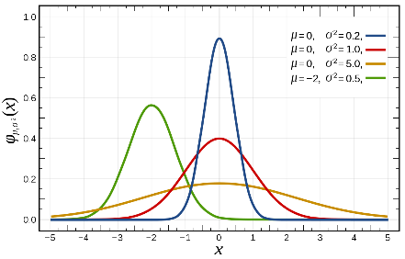
5. Kalman Filter
Gausian distribution
Q: System mode1 noise
R: Sensor mode1 noise
P: Relative formula
Z: Actual data
K: Kalman gain

Slide 23
5. Kalman Filter
: Raw data
: Filtered data

Slide 24
5. Kalman Filter
: Raw data
: Filtered data
1

Slide 25
5. Kalman Filter
: Raw data
: Filtered data
2
1

Slide 26
5. Kalman Filter
: Raw data
: Filtered data
2
1

Slide 27
5. Kalman Filter
: Raw data
: Filtered data
3
2
1

Slide 28
5. Kalman Filter
: Raw data
: Filtered data
3
2
1

Slide 29
5. Kalman Filter
: Raw data
: Filtered data
4
3
2
1

Slide 30
5. Kalman Filter
: Raw data
: Filtered data
4
3
2
1

Slide 31
5. Kalman Filter
: Raw data
: Filtered data
5
4
3
2
1

Slide 32
5. Kalman Filter
: Raw data
: Filtered data
5
4
3
2
1

Slide 33
5. Kalman Filter
6
: Raw data
: Filtered data
5
4
3
2
1

Slide 34
5. Kalman Filter
6
: Raw data
: Filtered data
5
4
3
2
1

Slide 35
5. Kalman Filter
: Raw data
: Filtered data
6
5
4
3
2
7
1

Slide 36
5. Kalman Filter
: Raw data
: Filtered data
6
5
4
3
2
7
1

Slide 37
5. Kalman Filter
: Raw data
: Filtered data
6
5
4
3
8
2
7
1

Slide 38
5. Kalman Filter
: Raw data
: Filtered data
6
5
4
3
8
2
7
1

Slide 39
5. Kalman Filter
: Raw data
: Filtered data
6
5
9
4
3
8
2
7
1

Slide 40
5. Kalman Filter
: Raw data
: Filtered data
6
5
9
4
3
8
2
7
1

Slide 41
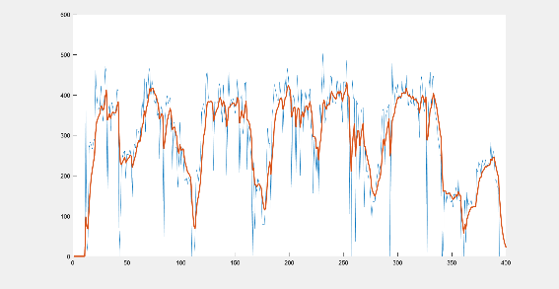
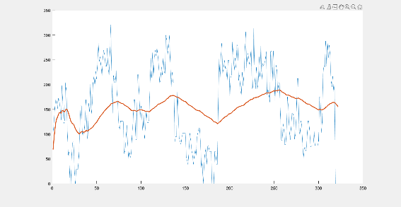
5. Kalman Filter
Different Q, R calibration

Slide 42
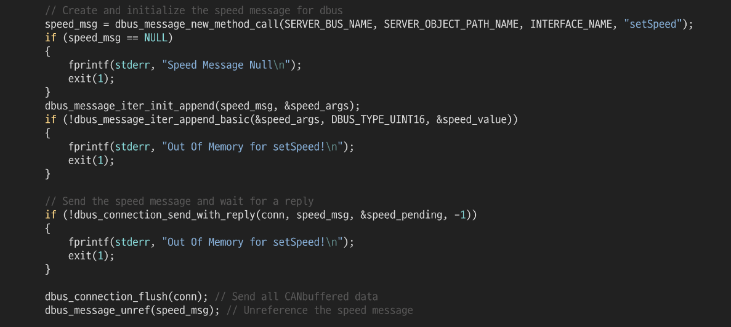
6. D-Bus

Slide 43
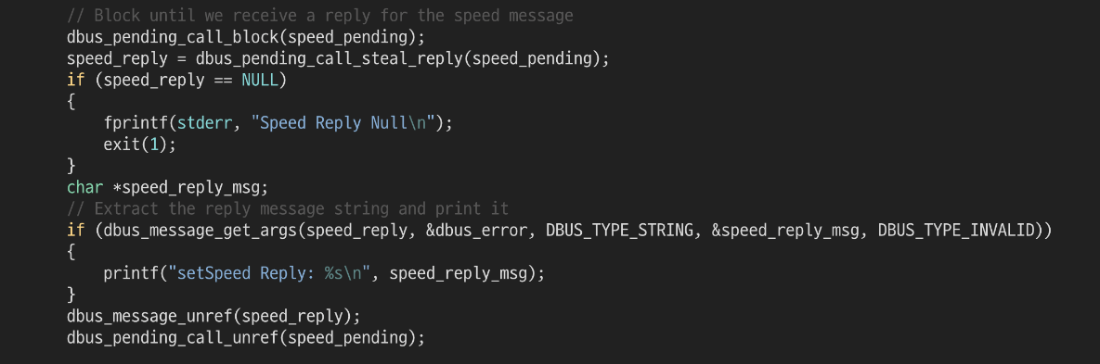
6. D-Bus
DBusPendingCall
synchronous
asynchronous
dbus_pending_call_block
dbus_pending_call_set_notify

Slide 44
7. Qt
Send(C, Python)
Receive(Qt)
QString setSpeed(quint16 speed);
QString setBattery(qreal battery);
QString setGear(quint8 gear);
QString setRpm(quint16 rpm)
Q_INVOKABLE quint16 getSpeed();
Q_INVOKABLE qreal getBattery();
Q_INVOKABLE quint8 getGear();
Q_INVOKABLE quint16 getRpm();

Slide 45
7. Qt
function run_ui() {
valueSource.speed = carinfo.getSpeed()
valueSource.battery = carinfo.getBattery()
valueSource.rpm = carinfo.getRpm()
〮〮〮
}
Timer {
interval: 250; running: true; repeat: true
onTriggered: valueSource.run_ui()
}

Slide 46
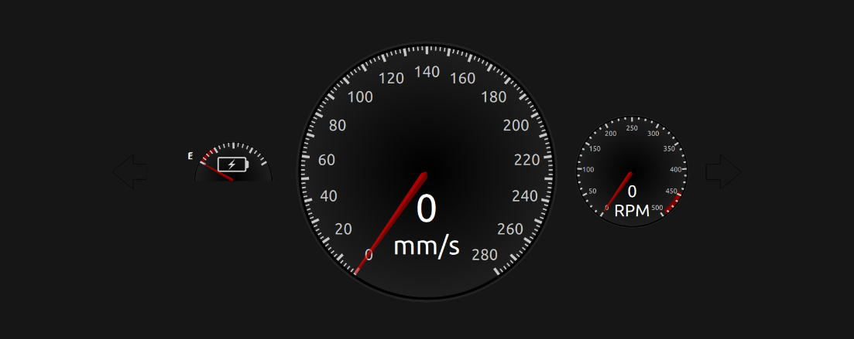
7. Qt

Slide 47
Thank you!
Q&A
DongHwan Seo
Mounika Vinjarapu
Sujong Ha
18.08.23

